Slide 1
Introduction to the Microbiome

Slide 2
Learning Objectives
Describe the commensurable relationship between humans and microbes, including major location-dependent microbiomes on the human body.
Evaluate the stability and malleability of the microbiome, in relationship to genetic or life-course dependent changes.
Consider the environmental factors that shape the gut microbial niche, and how that affects the kinds of bacterial species that flourish. Use this information to predict how bacteria species may be altered by diet.
Evaluate the role of fiber in providing fuel to the microbiome. Using the physical properties of polysaccharides in fiber, explain why these nutrients are particularly important for microbial function.
Explain the methods by which the microbiome is assessed, including the strengths and weaknesses of each methodology.
Describe the relationship between the gut microbiome and the immune system.
Compare descriptive and interventional studies of microbiota-disease relationships and use this information to consider the strength of the relationship.

Slide 3
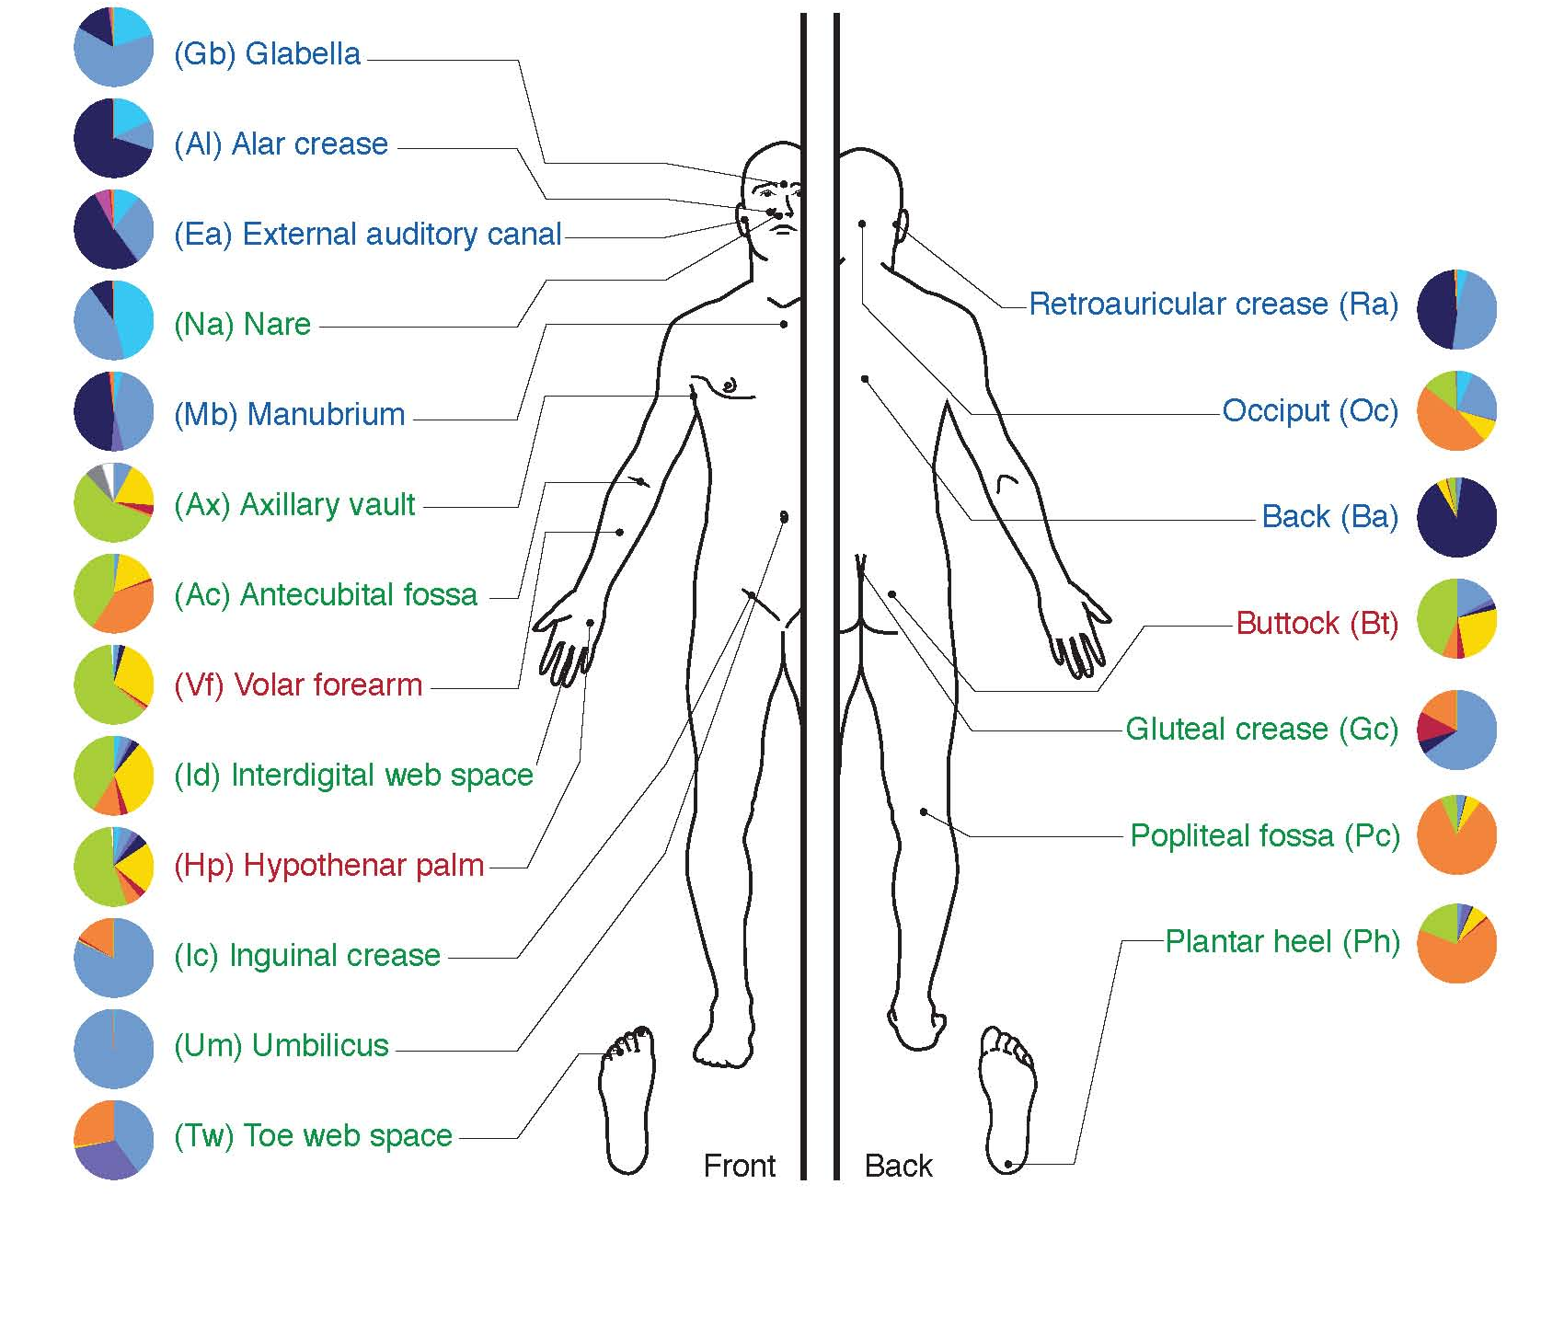
Where are the microbiota on the human body

Slide 4
The Gut Microbiome
Activity
Consider the environment where the highest bacterial load exists
Are these bacteria likely to be aerobic or anaerobic
What sources of food are present?
Predict how some change in diet might affect the kinds of bacteria present

Slide 5
Factors that Modulate the Microbiome
Maternal microbes
Diet
Environmental exposures
Genetics
The host can influence colonization

Slide 6
How can we modify our gut microbial communities
Prebiotics
Selectively fermented ingredient that changes microbial composition and/or activity
Probiotics
Live bacteria meant to colonize

Slide 7
How do we assess the microbiome?

Slide 8
Video
https://www.ted.com/talks/rob_knight_how_our_microbes_make_us_who_we_are

Slide 9
Minute paper
What is something you learned that you didn’t know before?
What is a question that this brought up in your mind?
Discuss with your table

Slide 10
Key Roles of the Gut Microbiome
Development of the gastrointestinal system
Immune barrier function
Energy extraction

Slide 11
Microbiomes Differ in Lean and Obese Humans

Slide 12
Can the gut microbiome modify energy extraction?
Ridaura VK, Faith JJ, Rey FE, Cheng J, Duncan AE, Kau AL, Griffin NW, Lombard V, Henrissat B, Bain JR, Muehlbauer MJ, Ilkayeva O, Semenkovich CF, et al. Gut Microbiota from Twins Discordant for Obesity Modulate Metabolism in Mice. Science (80- ). 2013; 341: 1241214–1241214. doi: 10.1126/science.1241214.

Slide 13
What is the form of this energy?
Gas waste
Carbon dioxide (CO₂)
Methane (CH₄)
Hydrogen Gas (H₂)
Hydrogen Sulfide (H₂S)
Short chain fatty acids
Metabolism will be covered in lipid oxidation lecture
SCFA | Used in
Acetate (C2:O) | Blood/Liver
Priopionate (C3:O) | Blood/Liver
Butyrate (C4:0) | Primary Energy Source for Colonocytes

Slide 14
What can we digest, what can bacteria digest?
Humans make α-amylase (α-1,4-glucose linkages)
Some make β-galactosidase (lactase)
Porter, N. T. & Martens, E. C. The Critical Roles of Polysaccharides in Gut Microbial Ecology and Physiology. Annu Rev Microbiol 71, 349–369 (2017).

Slide 15
Microbial Effects on Volumetric Diets
Small pilot study (n=26)
Volumetric diet (3 months)
﻿The nutritional intervention involved a volumetric approach that included larger amounts of fruits, vegetables, and low energy density foods with lesser intake of foods with greater nutrient density.
Mean weight loss was 3.7kg (3.8%)
Evaluated microbiota pre-diet to weight outcomes
Questions to consider:
How do you think the fiber intake changed in the diet?
What metabolic functions of the microbiome before the diet do you think may have been predictive of poor weight loss?
How do you think the microbiome may have changed over the course of three months

Slide 16
Microbial Predictors of Poor Weight Loss
Bacteria with more enzymes of carbohydrate metabolism predicted lack of success in weight loss

Slide 17
Other bacterial metabolites
Choline and carnitine metabolism
Bile salt conjugates (CA/CDCA/TBMCA)
Can act as signals to tissues such as brain and liver.
SCFA Fatty Acid Receptors (GPR41/43)
Bile Acid Receptors (FXR and TGR5)

Slide 18
Two downsides of having excess digestion in the colon
Solutes in the colon retain water
diarrhea
Microbes that produce excessive gas
flatulence

Slide 19
Microbes and flatulence
Endogenous gas
largely in colon, from fermentation:
Raffinose (Gal-Glu-Fru)
Beans, cabbage, brussel sprouts, asparagus
Stachyose (Gal-Gal-Glu-Fru)
Green beans, soybeans, beets, sweet potatoes
Verbascose (Gal-Gal-Gal-Glu-Fru)
Legumes
Lactose (Gal-Glu)
for those who are lactose intolerant)
Discuss why this would reduce gas formation?
Notes:
For example, need a-Galactosidase to digest the first three and b-Galactosidase to digest the last two

Slide 20
FODMAPS
Fermentable Oligosaccharides
Fructans (like inulin or levan)
Polyfructose with glucose at reducing end
Galactans
Polygalactose
Disaccharides
Mainly lactose
Monosaccharides and
Mainly fructose
Polyols
Sorbitol, mannitol, polyols (some fruits and sweeteners)
Galactan
Inulin – a Fructan
(β-2,1-polyfructose, with a glucose at reducing end)

Slide 21
Review Question
Why might someone be sensitive to fructans?
For some individuals, fructans are undigestable by alpha amylase
Fructans bind water and are retained in the stomach
In some individuals fructans may be digested slowly in the large intestine
Fructans are degraded to fructose in the small intestine, which is poorly absorbed and ends up in the large intestine

Slide 22
High and Low FODMAP Foods

Slide 23
Barrier Functions and Colon Health

Slide 24
Mucous Membranes are Protective Barriers Made of Polysaccharides Produced by Gut Cells

Slide 25
Endogenous Glycans As Bacterial Energy Source
Desai, M. S. S. et al. A Dietary Fiber-Deprived Gut Microbiota Degrades the Colonic Mucus Barrier and Enhances Pathogen Susceptibility. Cell 167, 1339–1353.e21 (2016).
Notes:
When the bacteria run out of good food, they start degrading the polysaccharides in the mucus layer, this makes the cells more prone to pathogenic infections and epithelial cell damage.

Slide 26
Immune Function and Gastrointestinal Development

Slide 27
Microbes and Development of the GI System
Epithelial cells respond to bacterial signals
MAMPS (Microbe associated molecular patterns)
Immune system communicates learns which bacteria to support and which to kill:
AMPS (Antimicrobial peptides)

Slide 28
Inflammation can result from loss of barrier function
Inflammatory Bowel Disease (IBD)
Cramps
Diarrhea
Fever
Weight Loss and Loss of Appetite
Blood Loss (anemia)

Slide 29
Human Milk Oligosaccharides
Often our first probiotics
Promotes growth of particular bacterial species that can metabolize these carbohydrates
Vary with genetics/diet/health
Promotes Specific
Bacterial Colonization
GI/Immune
Development
HMO
Lactose at one end

Slide 30
Should Public Policy Encourage Breastfeeding?
Positive Benefits
Negative Consequences
Nutrients not present not in formula or milk
Psychological bonding
Convenient and inexpensive
Sterile source of liquids (important for developing countries)
Can be inconvenient, requires lifestyle modifications
Can be painful
Stressful especially at beginning
Partner cannot breastfeed

Slide 31
Learning Objectives
Describe the commensurable relationship between humans and microbes, including major location-dependent microbiomes on the human body.
Evaluate the stability and malleability of the microbiome, in relationship to genetic or life-course dependent changes.
Consider the environmental factors that shape the gut microbial niche, and how that affects the kinds of bacterial species that flourish. Use this information to predict how bacteria species may be altered by diet.
Evaluate the role of fiber in providing fuel to the microbiome. Using the physical properties of polysaccharides in fiber, explain why these nutrients are particularly important for microbial function.
Explain the methods by which the microbiome is assessed, including the strengths and weaknesses of each methodology.
Describe the relationship between the gut microbiome and the immune system.
Compare descriptive and interventional studies of microbiota-disease relationships and use this information to consider the strength of the relationship.

